Slide 1
Strategic Water Partners Network
Strategic water partnerships for development
South Africa, Strategic Water Partners Network

Slide 2
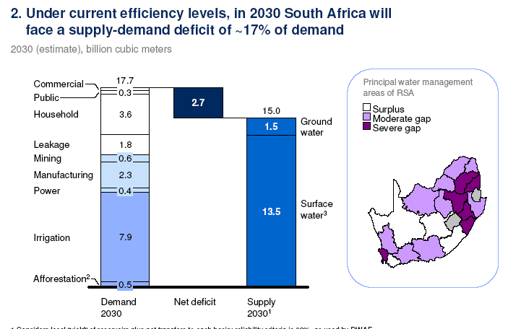
Addressing the water risk in SA requires partnership
Notes:
Potential speaking points
Water=3rd global risk of concern. In SA some areas already in deficit.
For business this is a business risk that cannot be mitigated by efficiency within facilities
3. CDP. > 70 of business have experienced water impacts in last five years.
4. Moody’s . Scarcity will increase rating pressure on mines
5. It is increasingly clear that wider, non traditional and strategic partnership are required at the scale of the risk; collective action is a must .
6. This has given rise the SWPN value proposition which will be evident below.

Slide 3
SWPN Overview
Initiative of Minister of DWS – 2011
Partnership between public/ private and civil society sectors aimed at closing the 17 % water gap by 2030
SWPN is a voluntary engagement platform where the private, public and civil society partners can contribute to the development and implementation of effective and innovative solutions to water and sanitation challenges in South Africa
SWPN provides access to decision-makers to ensure achievements have wide impact
Measure of success: volume of water saved and potentially made available for new users
Practical actions implemented in the short term, impact in long term

Slide 4
Governance and management Structure
Delegate to MANCO
STEERCOM
MANCO
WRG
DWS
CORE
COs
INVITED ORGS
Report PSC
DWA
Funders
NBF
STRATEGIC DIRECTION AND CONTROL
Management and control.
Working Groups
Report to Steercom
SECRETARIAT
DWS
COMPANIES
Admin support to Steercom, WGs and Project teams
Technical support to inform direction, policy, strategy
Stakeholder identification and management
Support to project formulation
Project management
Funding mobilization
Hosted by NBF
Report
PROJECT IDENTIFICTION AND CONTROL
Report to WGs
Project Steering Committee
WG
PM
Funder
PROJECT OVERSIGHT

Slide 5
Strategic focus areas to close the water gap
Priority areas based on:
Replicable models and interventions
Potential for scalable action
Opportunity for public-private partnership
Potential for High Impact
Effluent and Waste Water Treatment
Mine water management
Municipal waste water management and reuse
Water Use Efficiency and Leakage Reduction
Municipal and industrial water loss
Agricultural Supply Chain Water
Unlock funding and improve equity in water access for irrigation schemes
Water use efficiency in irrigation
Notes:
Effluent and wastewater management: Mine water could contribute about 11% of the water required to close the gap in the Olifants River catchment mentioned above. The water gap-closing initiatives will have value for mining companies, industry, municipalities, government and citizens in the vicinity of mining operations. This requires collaborative management at different scales. SWPN working is developing Institutional, Financial and Policy models that support such collaborative management in a sustainable way.
Water use efficiency and leakage reduction: Water loss in municipal systems in South Africa is estimated at about 32% while non-revenue water is about 37% and worth over R7 Billion annually. The Department of Water Affairs’ ‘Regulatory Performance Measurement System’ indicates that Water Use Efficiency is the poorest performing business area in local government. Through: (1) the No Drop Programme; (2) direct municipal-private sector partnerships that will be catalyzed by it (i.e. replication of Emfuleni); and (3) use of the Generic Performance Based Contract, the SWPN will contribute to improved water security for residents and businesses in municipalities where “No drop” service excellence is recognised.
Agriculture and supply chain: The agricultural sector accounts for about 60% of South Africa’s water demand. It is estimated that the river and canal conveyance system losses account for about 35% of this water agricultural water demand. Rehabilitating irrigation schemes offers water saving opportunities and would increase unit productivity, which has been reduced by waterlogging and salinization. The SWPN is assisting the Presidential Infrastructure Coordination Commission to develop a business case for rehabilitation of the Vaalharts, South Africa's largest and oldest irrigation scheme. This will include private sector support. The activities to rehabilitate the Vaalharts irrigation scheme could create jobs by making water available for new smallholder irrigators. Other activities such as the roll out of WAS are underway to reduce water loss in irrigation.

Slide 6
Action towards closing the gap…………

Slide 7
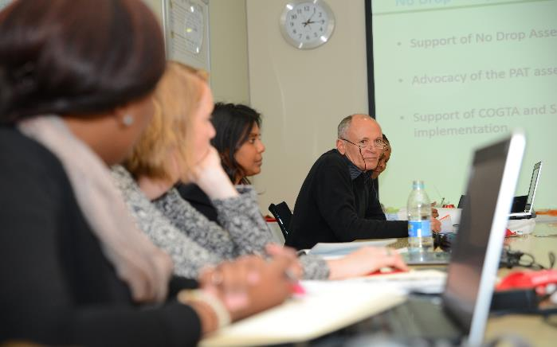
Water Use Efficiency and Leakage Reduction (WELR)

Slide 8
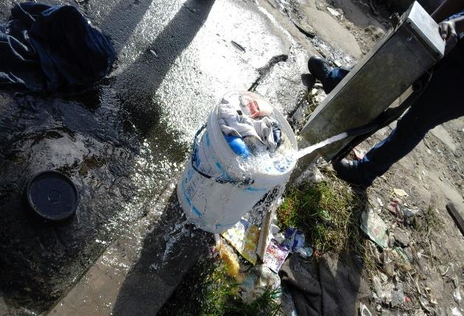
WELR Project
No Drop Incentive Based Monitoring
No Drop – developed to encourage progress in water use efficiency and water loss management in the South African Municipal Sector
SWPN and DWS developed set of criteria to collectively measure and assess
Non-revenue water management
Water Conservation and Demand Management
Water supply management
Target: Reduce municipal water losses to 18% by 2025 or earlier
Project savings in water: 630 million m³ per year
Projected savings in municipal finance: over R 2.5 Billion per year

Slide 9
The No Drop Value Proposition
The No Drop has proven itself to be a ‘driver of change’ which resulted in key imperatives within its short timespan:
Credible and verified information on water losses in the municipal sector
Current and accurate data
System, process and procedure to measure progress or digress on a continuous basis
An informed municipal sector and Community of Practice
A focussed, informed and results-orientated Regulator
Appreciation for technical and financial skills required for WCDM in municipalities
A Business Case for private-public partnerships
Rand-based opportunity and investment framework
Projects / intervention types to address the identified gaps.

Slide 10
Investment Opportunities
Opportunity :
R 6.3 billion lost as NRW per annum
R 2 – 3 billion saving possible per annum

Slide 11
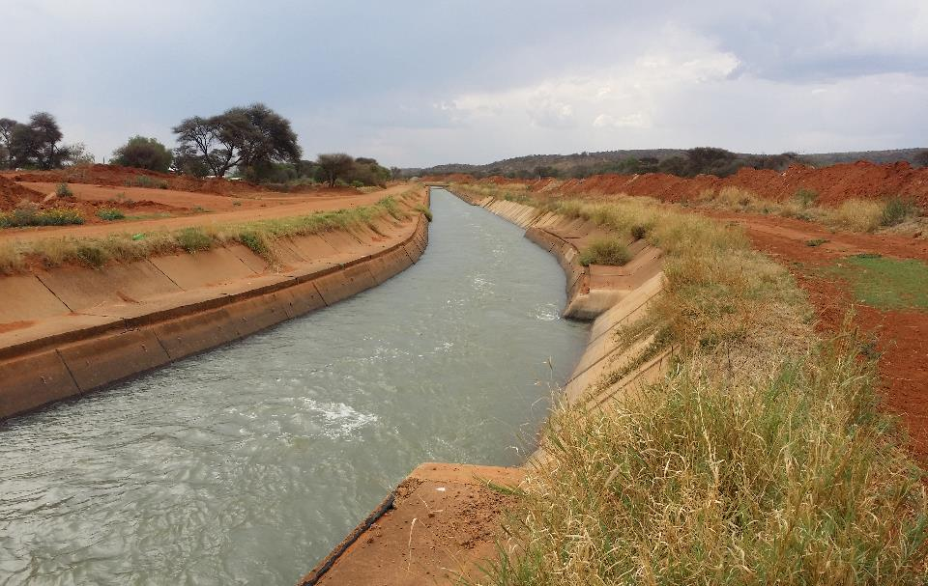
Agriculture and Supply Chain (ASC) Water
Notes:
SIP – Strategic Infrastructure Project

Slide 12
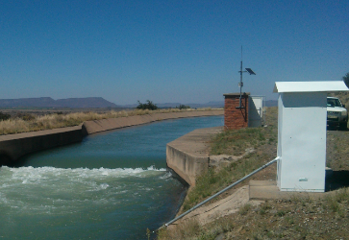
ASC Projects
Support of Water Administration System Roll out
WAS release module implemented in 4 large schemes
Indicative savings of 927 891m³/week = ±48 million m³/annum
Supporting the development of a FIP for the upgrading of the Vaalharts Irrigation Scheme – largest and oldest IS
Potential savings estimated at 40 million m³/annum - ±R4 billion investment required
create an additional 2,000 jobs to the existing 7,500
Contribute to equity targets through access to saved water

Slide 14
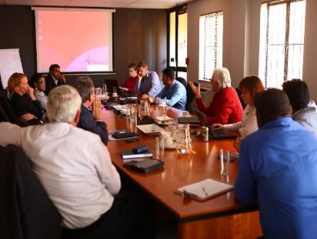
Effluent and Waste Water Management

Slide 15
Inconsistent regulation of mining
Inadequate regional planning
Developing (new)
Uneven DMR mining enforcement
Ineffective water use licensing
Weak DWA water use enforcement
Fragmented cooperation
Diverse corporate compliance
Operational
(ongoing)
Op mine dewater & runoff
Uneven information & awareness
Mining AMD
Viability of collaborative models
Collective response
Non-op decant & runoff
Non-operational
(old)
Unclear closure & liability requirements
Ring-fencing marginal mine liability
Inadequate non-op AMD financing
Facility-level Factors
Regional Factors
Notes:
Sustainable mine water management is a huge challenge. Issues related to mine water identified during the mine water project phase 1 which support the establishment of the mine water coordinating body as an outcome of the mine water project phase.

Slide 16
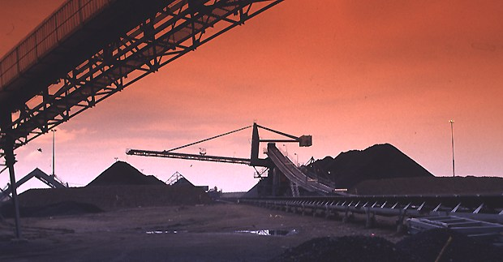
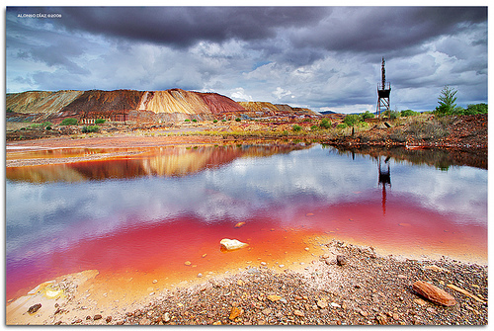
Project example : Sustainable mine water management
Mpumalanga is South Africa’s largest coal producing province
Mines generate jobs, income but also pollution
Basin projected to run into a water deficit by 2017
Pollution
Current mine water management not sustainable institutionally and financially
Improved water quality and 52.2 million m³ per year, closing the regional Olifants water gap by 26.2% in 2020
Developing the institutional and financial models and policy reforms required to support financially sustainable mine water management
Includes: (i) options analysis of collaborative interventions mine area catchment scale; and (ii) establishment of a public–private coordinating body

Slide 17
 | Period | Activity | Expected Outcome
Lead Agent: SWPN | 0 – 3 Months: Sept 2015 – Nov 2015 | Appointment of locally based project manager Initiate stakeholder lobbying process Scope high level activities and agree on governance structure | Appoint project manager for coordinating body Obtain commitment from initial partners First round table meeting with partners - Nov 2015
 | 3 – 6 Months: Dec 2015 – Feb 2016 | Develop 3 yr business plan for coordinating body Develop funding and financial management strategy Secure funding Develop flagship project | Put in place governance structures Well aligned strategic plan 3 yr business plan for coordinating body Financial strategy TOR for flagship project
Lead Agent: Coordinating Body | 6 – 12 Months: Mar 2016 – Aug 2016 | Develop investment strategy for the Coordinating Body Commence implementation of the 3yr business plan Begin ground work to establish broader reference group | Invest strategy for long term sustainability Implemented activities to improve WRM in Witbank Coalfields
 | 12 – 18 Months Sept 2016 – Feb 2017 | Increase staffing Establish broader reference and advisory group Identify additional potential projects Potential future initiatives may include - Look at alignment with OWQMP - Look at alignment with Olifants CMS | Regional catchment water and mining strategy Employment of project administrator and communications manager Establish reference and advisory group List of prioritised future initiatives

Slide 18
SDG Challenge
SDG 2 – End hunger, achieve food security and improved nutrition and promote sustainable agriculture
SDG 6 – Ensure availability and sustainable management of water and sanitation for all
SDG 9 – Build Resilient infrastructure, promote inclusive and sustainable industrialisation and foster innovation
SDG 17 – Strengthen the means of implementation and revitalise the global partnership for sustainable development

Slide 19
Participation in SWPN
Working Groups
Voluntary – Constructive inputs
Project identification
Advocacy
Funding - secretariate
Project Basis
Project based funding
Technical input and expertise
Facilitation of partnerships per project
Project management and oversight

Slide 20
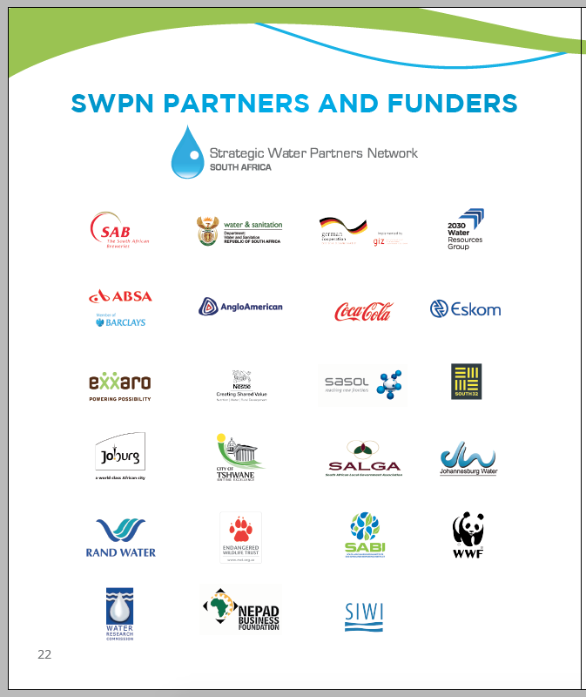
Partners
SWPN Partners for development and change
Notes:
Key partners in the fight to close the water gap

Slide 21
What Partnerships are not……
Silver bullets to address all the worlds ills
Circles of love around mountains of free flowing money
Short cuts for easy implementation
A group of people and organisations that miraculously mesh and suddenly have the same mandate, priorities and concerns

Slide 22
What Partnerships can be…..
A pool of expertise that can accelerate implementation when the goal is well understood
A platform to initiate change that can be owned and sustained across sectors
An avenue to unblock barriers to seemingly complicated challenges
A financial resource that demands accountability and impact

Slide 23
Key Factors for Successful Partnerships
Successful Partnerships for development are made possible by:
Common vision - recognition of water as a critical risk for economic, social and environmental sustainability
Shared understanding of issues to be addressed
Negotiated priorities – not just good for one but good for all
Trust between partners – integrity of role players
Champions – decisions must be made and responsibility taken

Slide 24
Lessons Learnt for Water Stewardship
Water stewardship is about leadership and mitigating shared risk
In order to accelerate action, incentives are required for both public and private sector
Local champions and mobilisers are necessary
Multiple funding sources – cross sectoral collaboration and complementary partners
Budget priority shifts are required: sustainability, reducing losses, pollution control
We must move from water stewardship being in the domain of philanthropy – structure projects with take off agreements and equity from private sector

Slide 25
Our diversity in perspective
is our strength

Slide 26
But…….

Slide 27
Thank you
A partnership between the Department of Water and Sanitation, the private sector and civil society working collectively to close the national water gap

